Slide 1

ARINC 429 Midterm Presentation
Team Caterpillar
10/15
This presentation outlines a the concept security gateway design of ARINC 429 data bus.

Slide 2



Our team
Team Caterpillar
Joshua
Nate
Brandon

Slide 3
Content overview ARINC 429
Team Caterpillar
1
2
3
What is ARINC
DREAD Overview
Spoofing
4
5
6
Replay
DoS
Conclustion

Slide 4

What is ARINC 429?
Team Caterpillar
The ARINC 429 is a data bus used in commercial, private, and military aircrafts to transport avionic data throughout the plane.
This includes all of the flight data like the radar, relative pitch and yah, airspeed, data to the black box and much more information.

Slide 5

How Does ARINC work?
1 transmitter sends data to up to 20 receivers through a single twisted wire pair in which it is unidirectional.
The LRUs transmits 32-bit words, in which 24 of those bits contain data and 8 bits describe the data.
There are no addresses for the LRUs but equipment IDs
Transmission rates can either be 12.5 kHz or 100 kHz with a deviation of 1 and only one of these rates can be used at a time.
Team Caterpillar

Slide 6

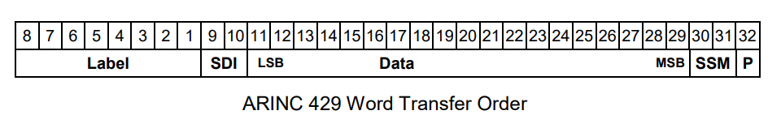
How Does ARINC work Continued
P (parity): P bit ensures there are an odd number of 1’s. If there are an even number of ones that means the word was damaged in transit.
SSM: Provides context for the data (cardinal direction, positive or negative, ect)
Data: The data that the receiving LRU interprets
SDI: Informs the LRU of all receivers
Label: Informs LRU on what type of data (velocity, radar, intercom, ect)

Slide 7
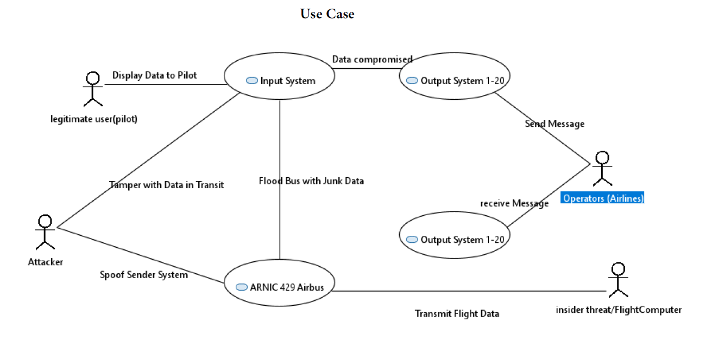
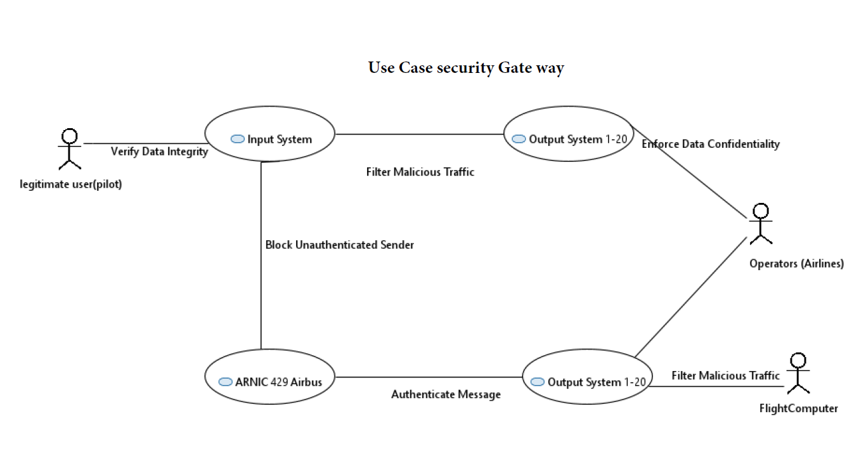
SYSML model (Use case)
Team Caterpillar
Normal Operations:
Transmit flight data
Display data to the Pilot
Identified Attack: spoof, Flood Bus…
Security Gateway Mitigations:
Authenticate to verify sender identity.
Verify data integrity to check for tampering.
Filter Malicious Traffic to stop bus flooding.
Enforce Data confidentiality.

Slide 8
Threat Modeling
Team Caterpillar
 | Denial of Service (DoS) | Altered Frames (Tampering) | Replay (Spoofing)
Damage | (3) Could cause systems to revert to reversion mode | (3) Can affect all receiving nodes on the same bus | (3) Can affect all receiving nodes on the same bus
Reproducibility | (2) The attacker needs access to the plane in order to carry on with the DoS attack but once they have it the it is easily repeatable | (1) Frame specifications varies by manufacturer | (3) does not require knowledge of data specifications, attack stays the same if the same LRU is compromised each time
Exploitability | (2) Needs physical access or privileged access to the avionics | (1) Requires physical access, custom malware, and knowledge of how receivers interpret data | (2) Requires physical access and custom malware
Affected users | (3) Potential for all passengers to be affected | (3) Potential for all passengers to be affected | (3) Potential for all passengers to be affected
Discoverability | (3) The protocol is public, but the bus architecture, label and data specifications are not public | (2) Knowledge of theoretical attack is easily discoverable due to public protocol information, however label and data specifications are not public | (2) Knowledge of theoretical attack is easily discoverable due to public protocol information, however label and data specifications are not public
Total | 13(High) | 10 (Medium) | 13 (High)

Slide 9
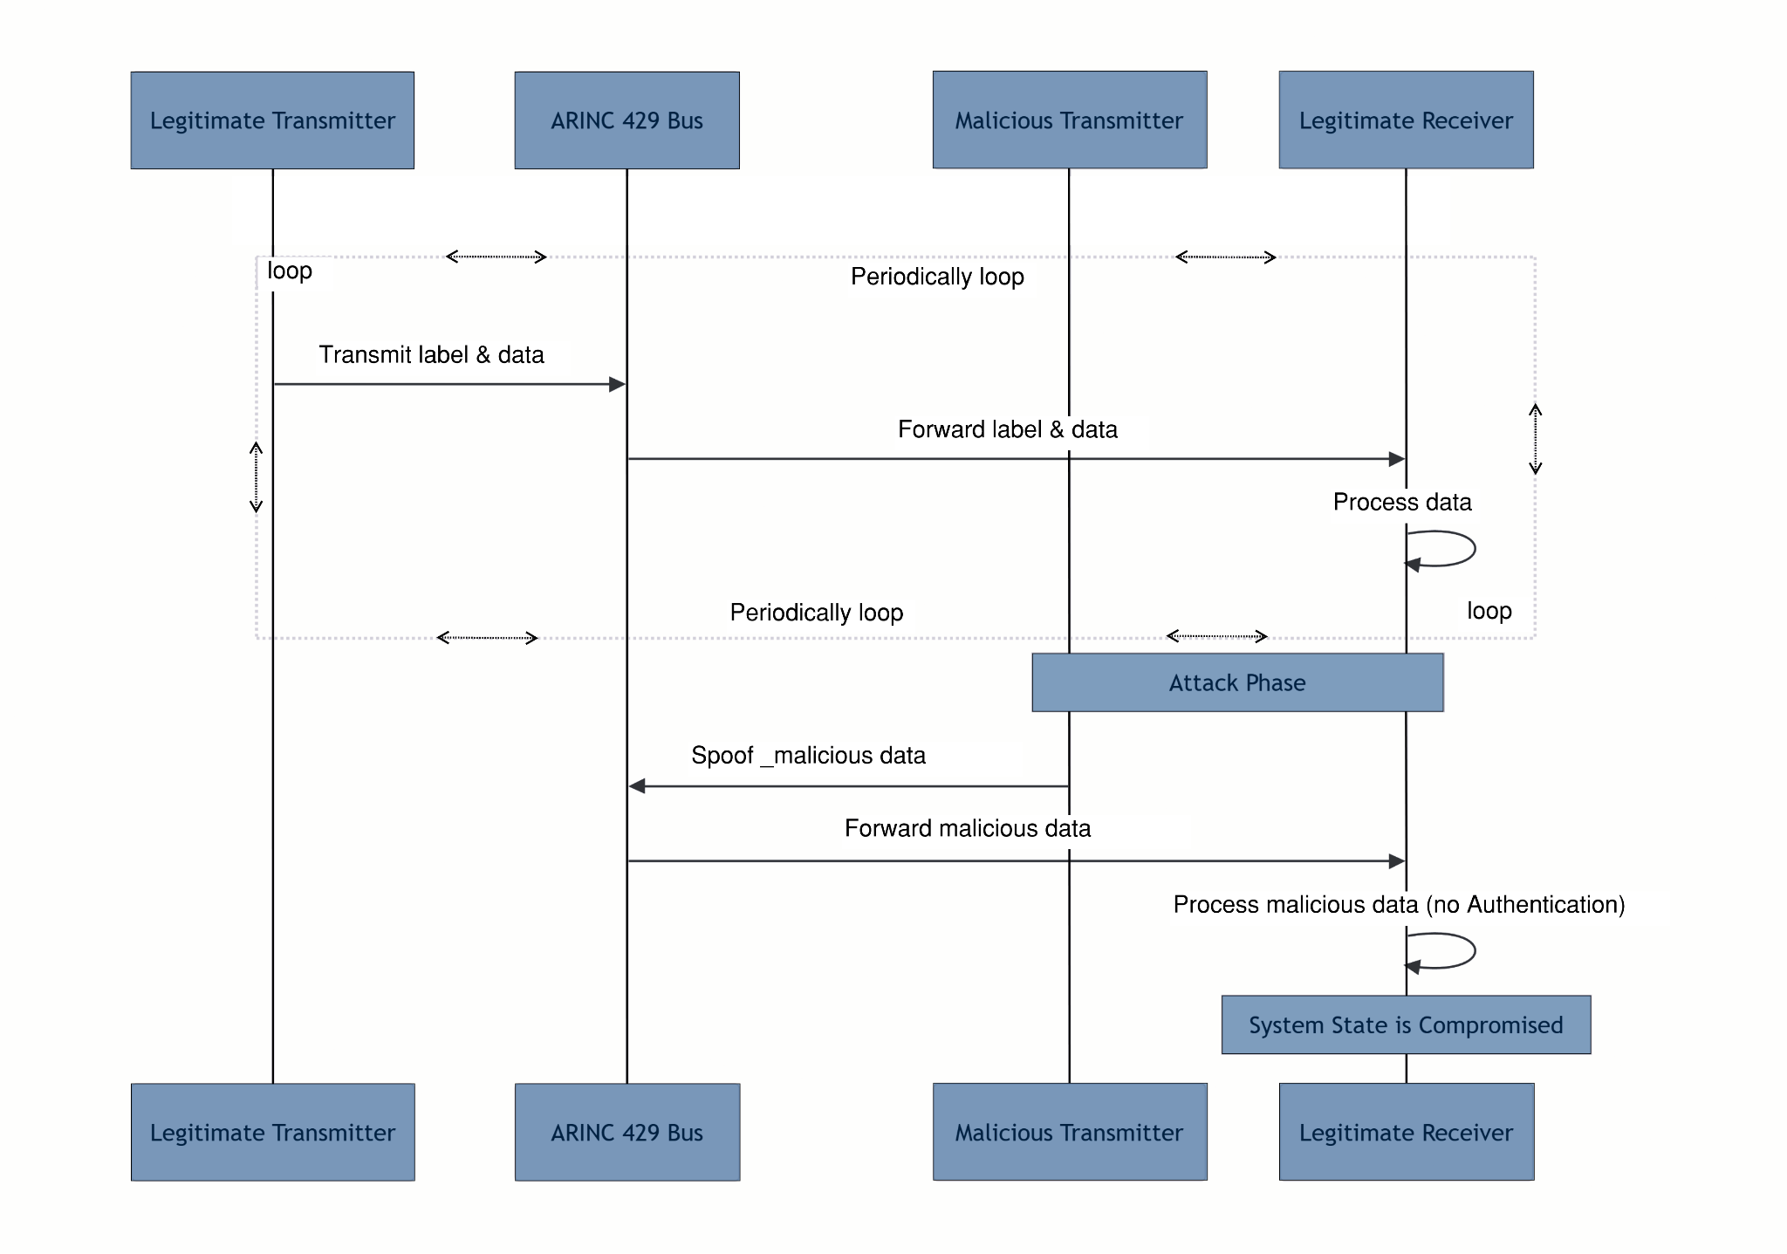
Spoofing Attack
Attack Explanation
Diagram illustrates the normal flow of ARINC 429 communication.
A malicious transmitter then joins the bus and sends a message with an identical label.
Receiver can’t distinguish the legitimate from the malicious.
Accepts and processes the spoofed data, leading to a compromised system.
SysML

Slide 10
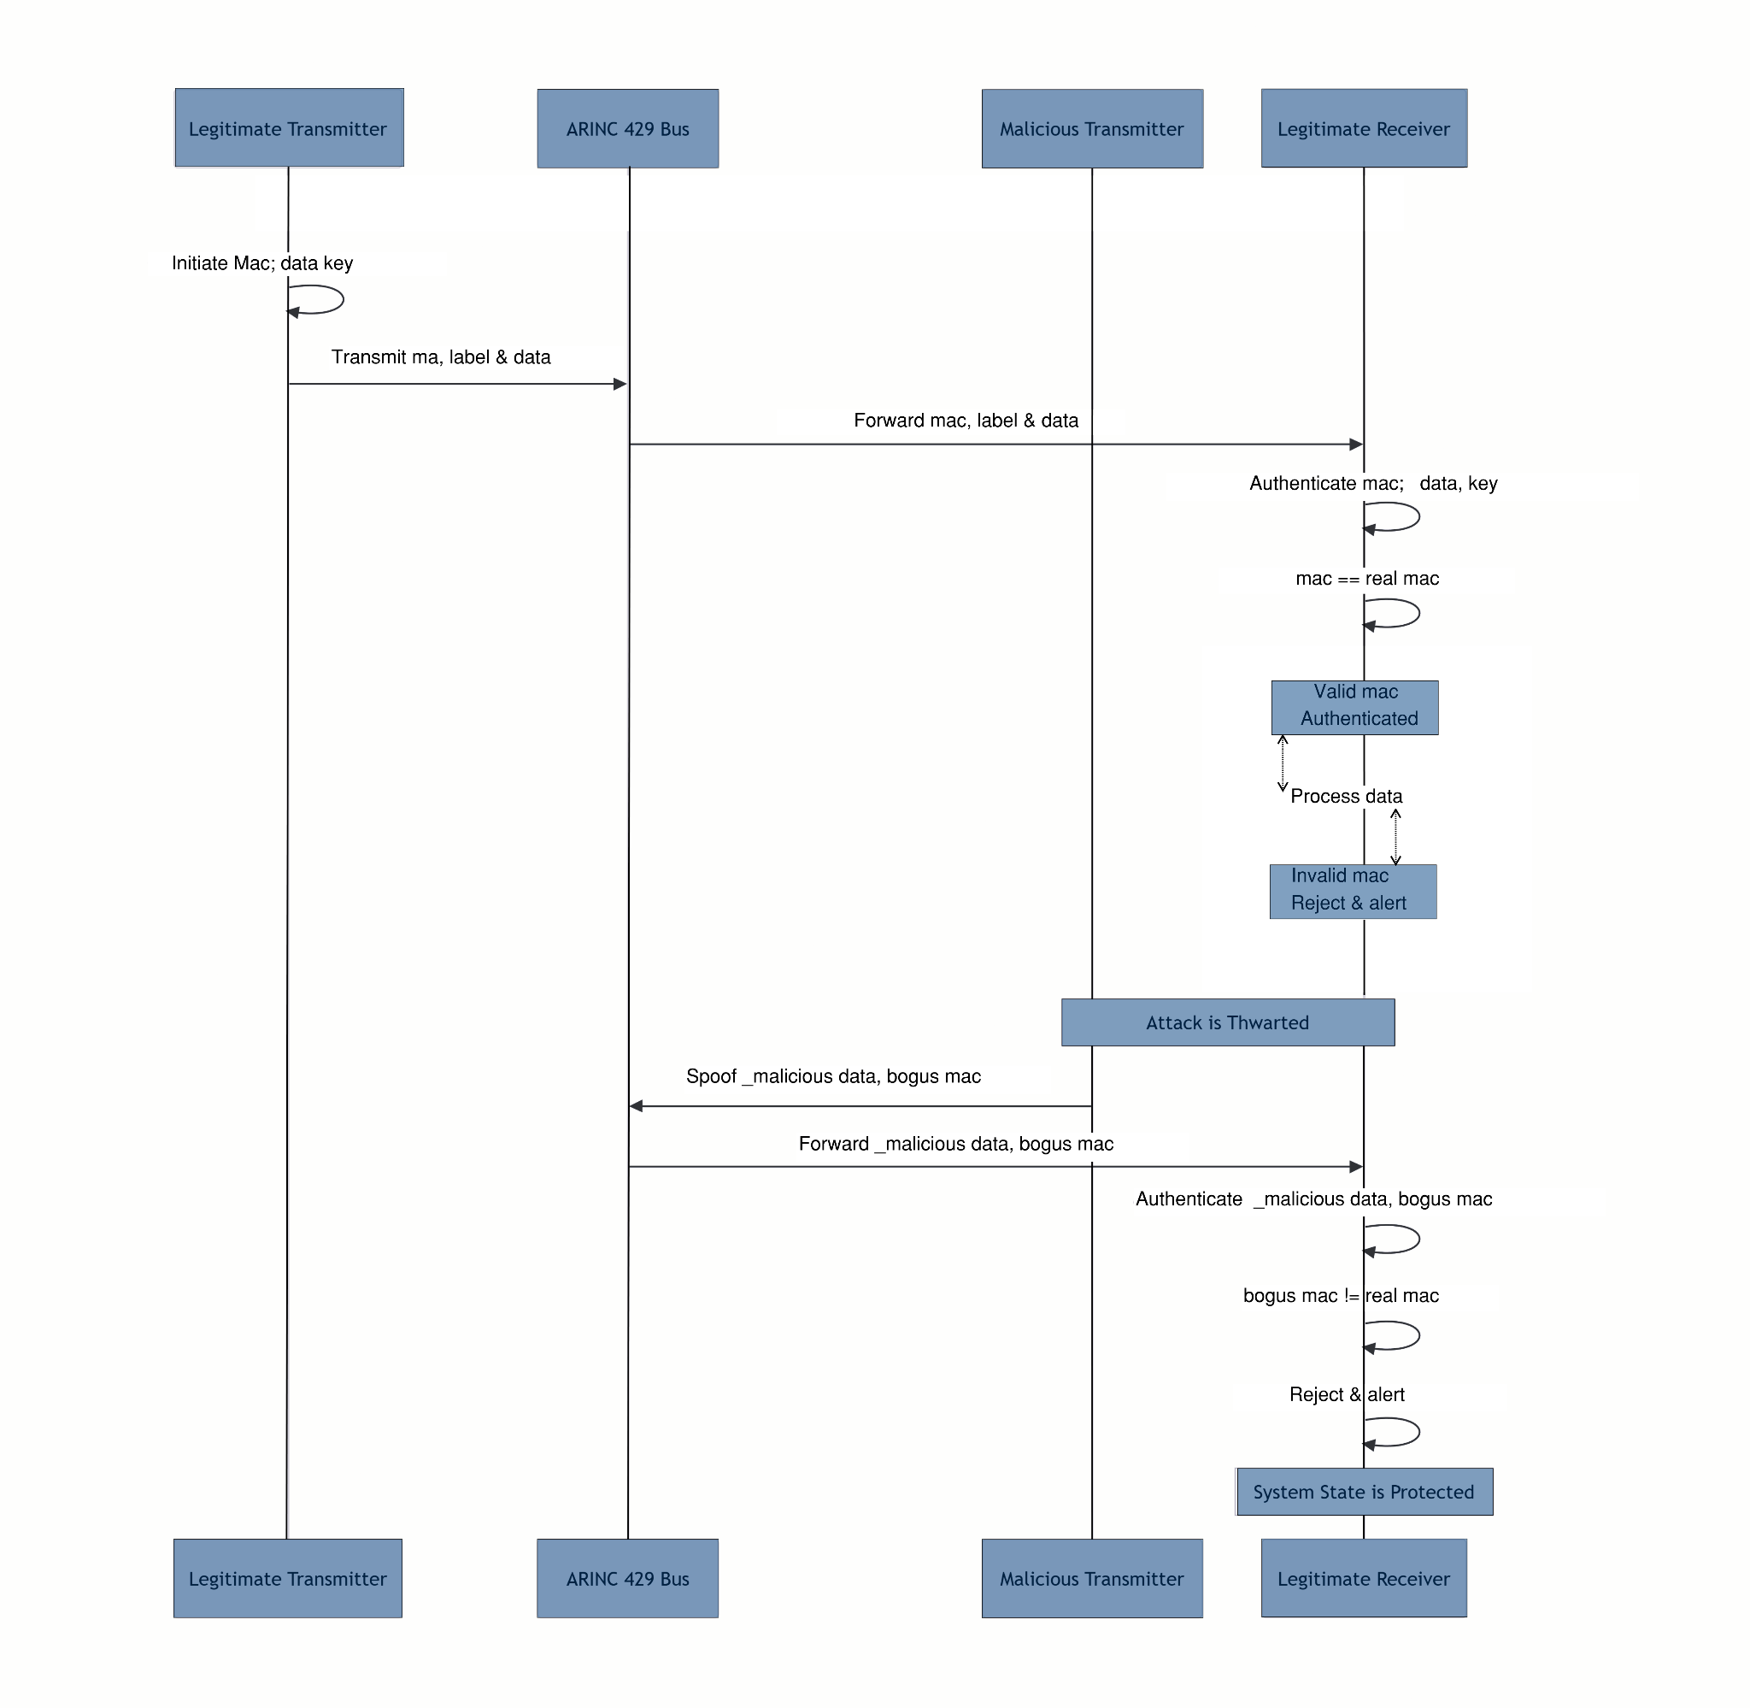
Spoofing Defence
Defence Explanation
Diagram illustrates proposed cryptographic authentication defense prevents the spoofing attack.
legitimate transmitter now generates a MAC using the shared secret key and appends it to the message.
Receiver validates the MAC (fake or no MAC or real) before processing the data.
Accepts real data, malicious data rejected, and an alert can be triggered.
SysML

Slide 11

Spoofing Demo

Slide 12
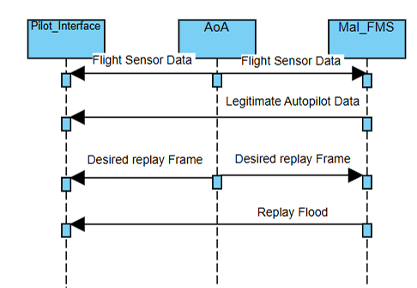
Replay Attack
Attack Explanation
SysML
The Attack works by having the malicious flight management capture its desired replay frame, and replay it over and over again to the pilot interface.
Because the Pilot interface has no authentication step, it accepts the malicious frames and allows for the attack to happen.

Slide 13
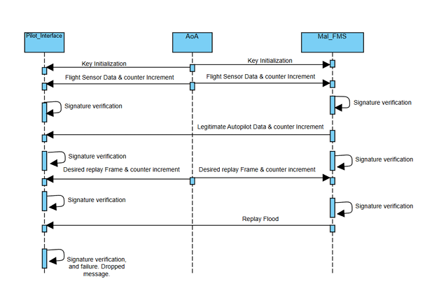
Replay Defence
Defence Explanation
SysML
Similarly to the Spoofing defence a shared key is generated and to create a MAC that is validated by the receiver to validate the authentication of the user. Additionally a NONCE is created through the use of a simple counter and is appended to a new field in the word (making a 40 bit word)
The receiving end checks the NONCE to ensure it is not a replay attack.

Slide 14

Replay Demo

Slide 15
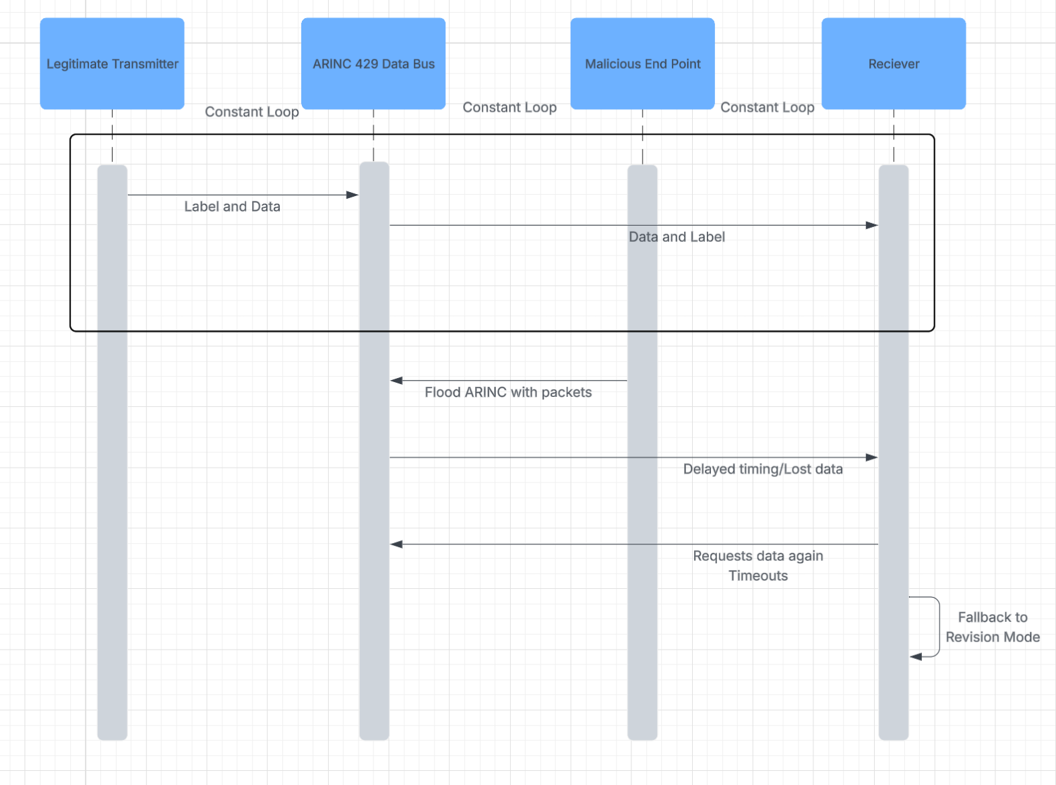
DoS Attack
Attack Explanation
The diagram to the right shows roughly how a DoS attack would perform in an ARINC 429 databus
Firstly, the attacker would need to have physical access to the wire and have a node connecting them to the databus.
Next, the malicious end point would flood the data bus with packets to the point where they are unable to send data properly, which results in delayed timing and lost of data.
Then, the receiver will tell the databus that the data was corrupted or uncomplete, in which the receiver will request for the databus to transmit again
Finally, the receiver will get a timeout error and will then go into revision mode to try and protect itself.
SysML

Slide 16
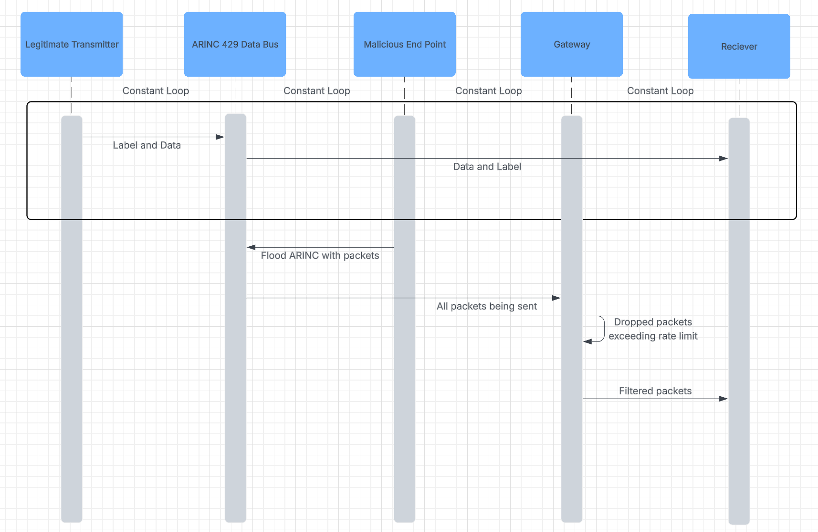
DoS Defence
Defence Explanation
This defense differs to the ones before, where we are implementing a gateway between the data bus and the receiver, which is exemplified in the diagram to the right. First the attacker floods the data bus with packets, and instead of the data bus sending them directly to the receiver, they go through a gateway.
Then, this gateway enforces rate limits per transmitter and creates a buffer of packets being sent ensuring timing is correct.
Finally, the filtered packets are then sent from the gateway to the receiver and the receiver then processes these packets.
SysML

Slide 17
Conclusion & Lessons Learned
Recommendations
Add a MAC signature to verify authentication
Add a NONCE to ensure there is no replay
Actively Monitor, and ensures compliance security requirements.
Add a gateway to drop packets that exceed the rate parameters
Challenges
Flashing the key to each system
Checking and monitoring everyone that have access to the bus.
Identifying breaches during operations

Slide 18

References and Questions?
[1] https://github.com/JoshuaMFrench/CYSE465-Caterpillars-Group
[2] B. Waldmann. ARINC 429 Tutorial, v2.2. (2019). Accessed: September 12th, 2025. [Online]. Available: https://www.aim-online.com/wp-content/uploads/2019/07/aim-tutorial-oview429-190712-u.pdf
[3] https://www.omg.org/sysml/INCOSE-OMGSysML-Tutorial-Final
Team Caterpillar

Slide 19
Individual Contribution
Team Caterpillar
Josh
Nate
Brandon
Team Effort
Initial case study for the proposal with team
Replay attack
Replay Defense
Replay SysML
Replay Demo
Final Report
Initial case study for the proposal with team.
System Architecture (Sysml model).
Spoofing attack
Spoofing Defense
Spoofing SysML
Spoofing Demo
Final report
Initial case study for the proposal with team
DoS Attack
Dos Defense
Dos SysML
Final Report
It was “All hand on deck” approach for the project in the beginning. Once we figured out our attack vectors, we then split into our our sections. Josh did the replay attack, Nate did the spoofing attack, and Brandon did the DoS attack. Once that was completed, we came together to write the report and presentation

Slide 20
Thank you

